Slide 1
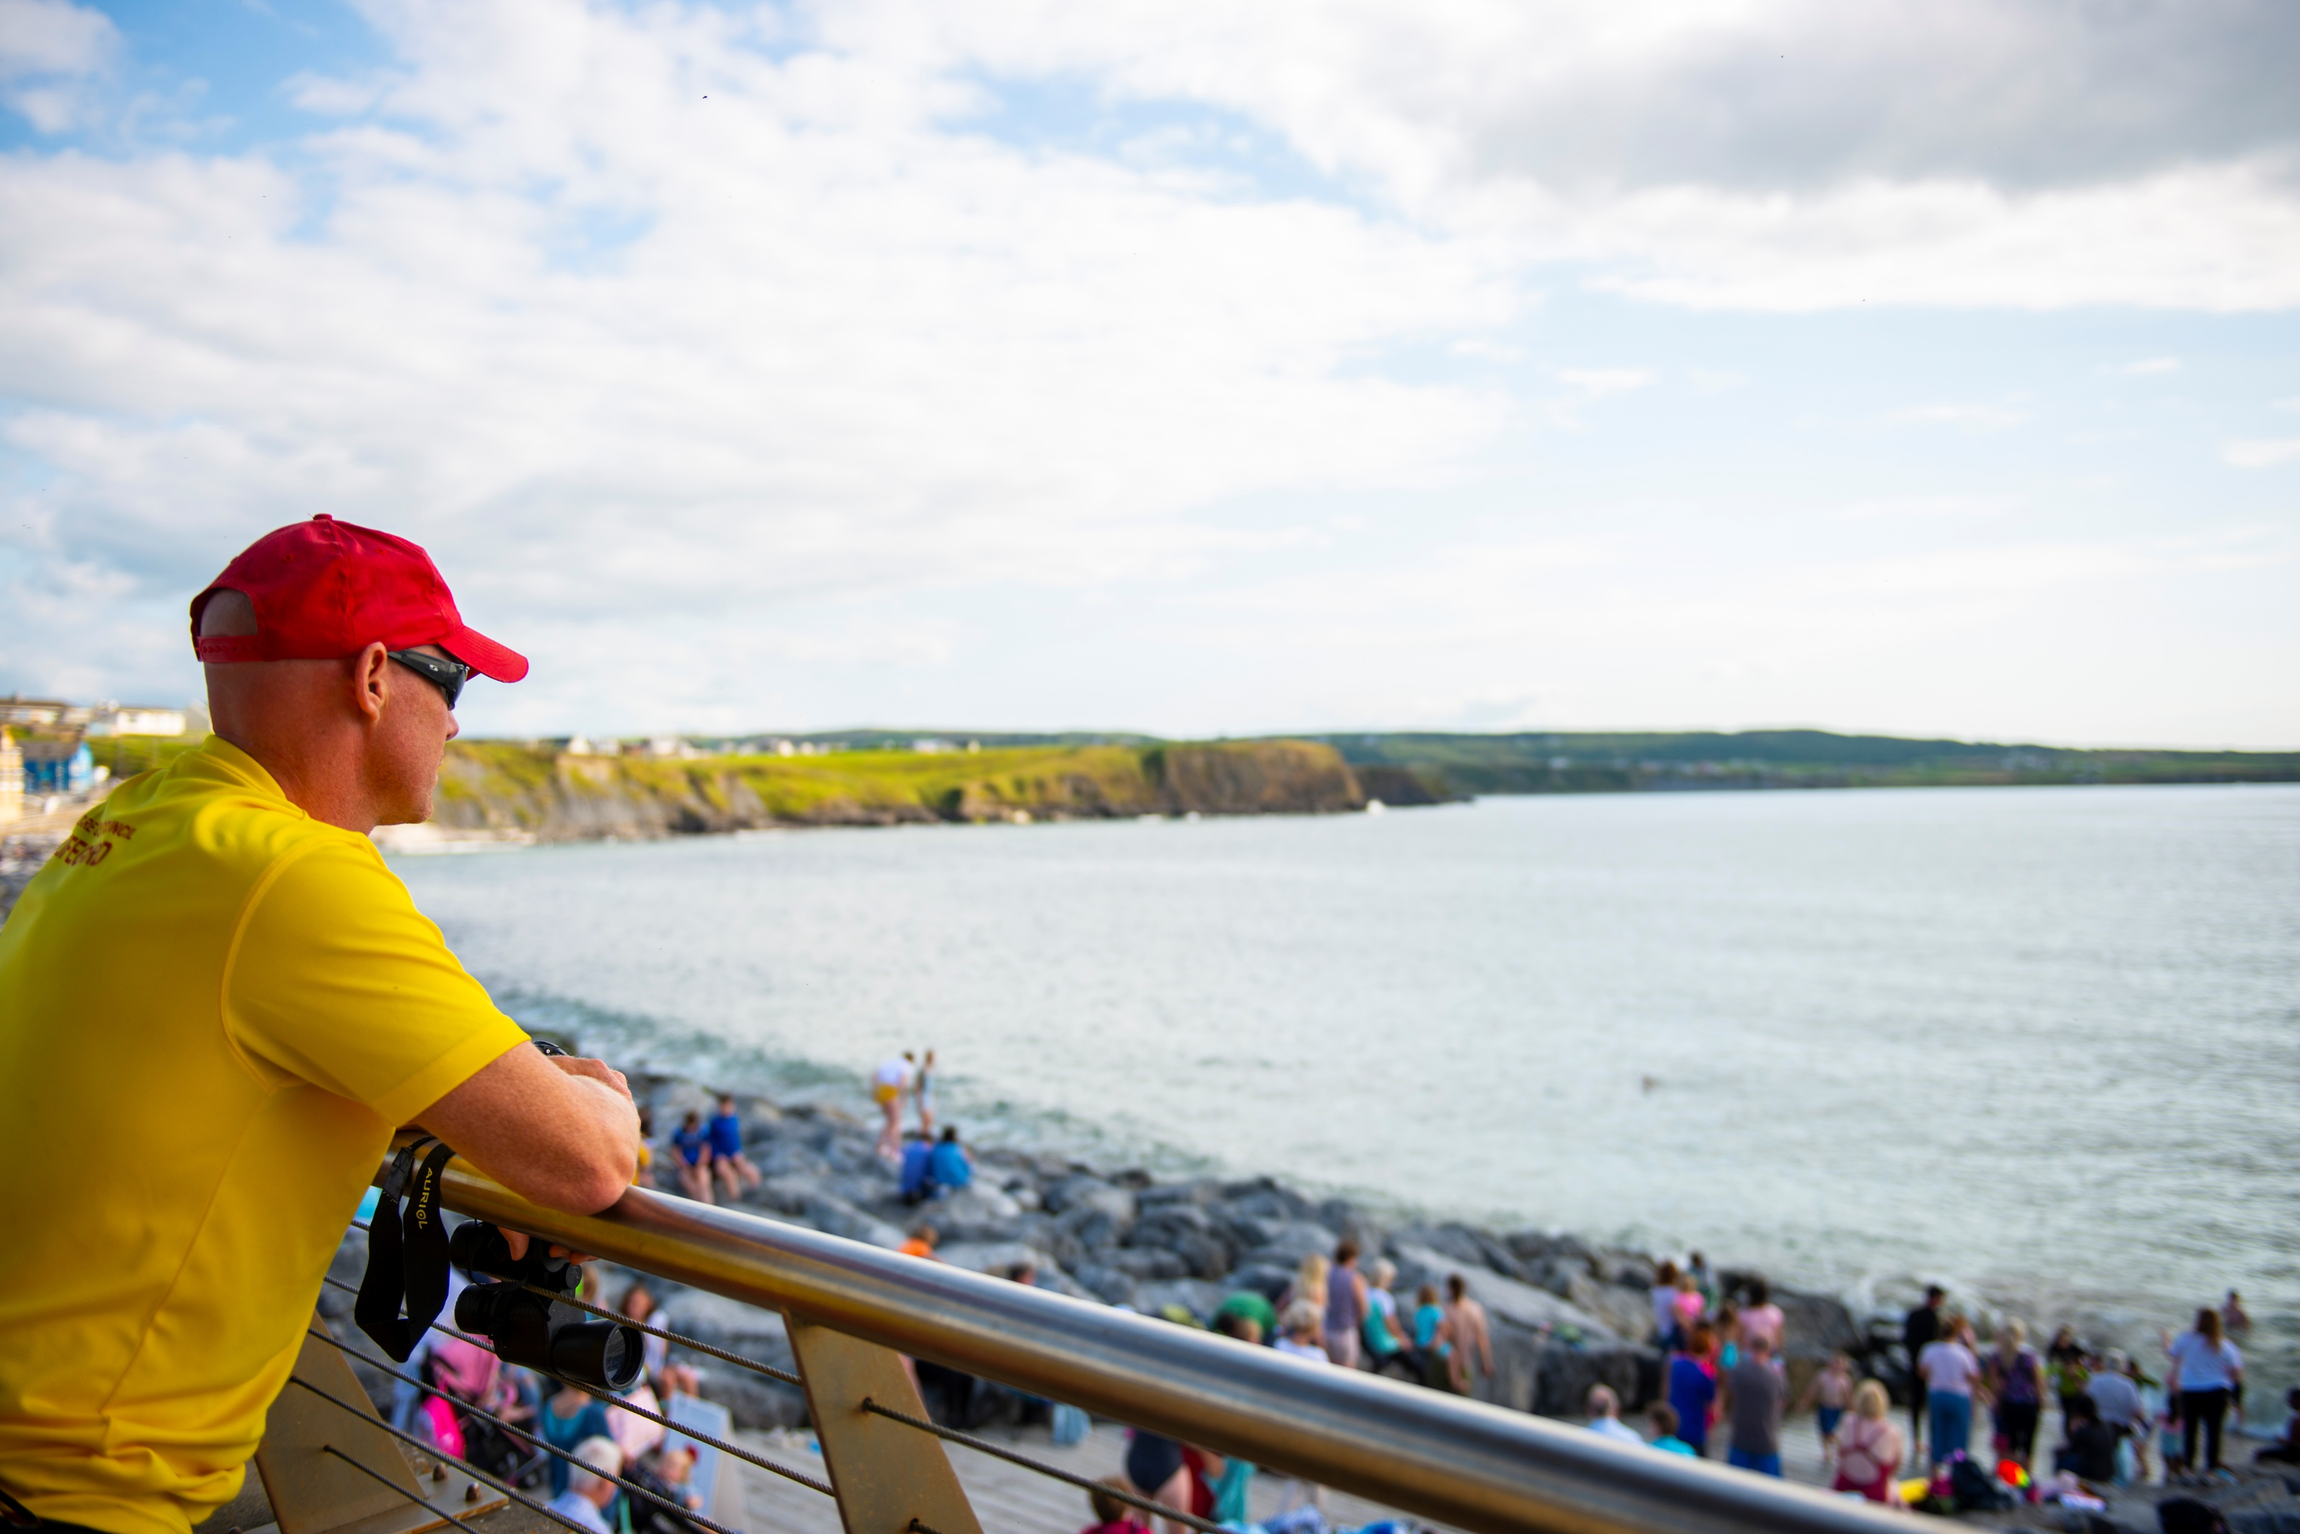
Have your say on Bathing Areas
Each year, your council identifies official bathing areas so they can be monitored for safety and water quality.
If you want to suggest bathing areas, let your council know by August 28th.
Visit your council’s website to find out how to make a submission.

