Slide 1
Wicklow County Archives Service Researching History
A quick guide to finding and recording information on an historical topic

Slide 2
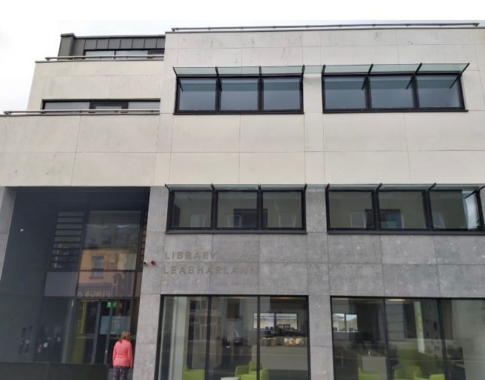
About the Archives
Located in Wicklow Library, Wicklow town
Records of the administration of the county - the people's interaction with those bodies
Wicklow County Archives Service records date from the 1600s
Rich resource for the family and local historian, academics and researchers of wide and varying interests.

Slide 3
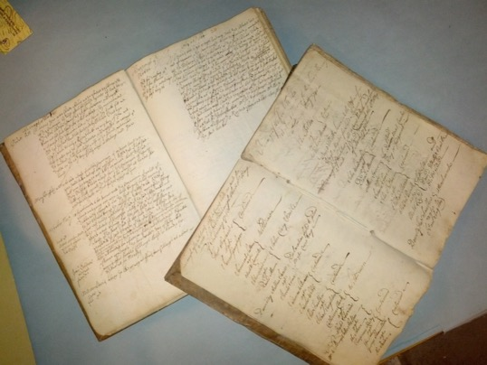
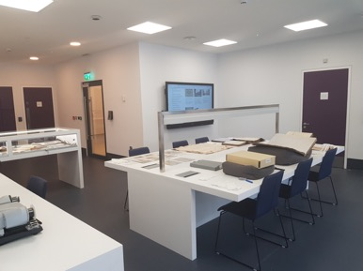
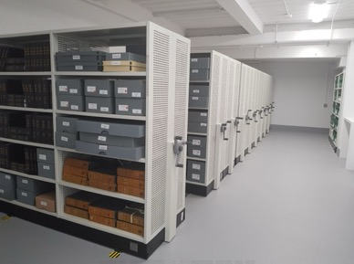
About the Archives
Main Collections
Collection | Period | Online
Wicklow Borough Corporation | 1662 - 1848
Wicklow Grand Jury Presentments | 1818 - 1899 | Y
Rathdrum Workhouse Records | 1842 - 1914 | Y
Rathdrum Poor Law Union / Board of Guardians Minute Books | 1842 - 1921 | Y
Shillelagh Workhouse Records | 1842 - 1918 | Y
Shillelagh Poor Law Union / Board of Guardians Minute Books | 1852 - 1921 | Y
Wicklow County Council Minute Books | 1899 - present | Y
Wicklow Town Commissioners Minute Books | 1847 - 1899 | Y
Wicklow Urban District Council Minute Books | 1899 - 2014 | Y
Arklow Town & Urban District Council Minute Books | 1878 - 2014 | Y
Bray Town Commissioners Minute Books | 1857 - 1898 | Y
Bray Urban District Council Minute Books | 1898 - 2014 | Y
Private / Business Collections | 18th - 20th century

Slide 4
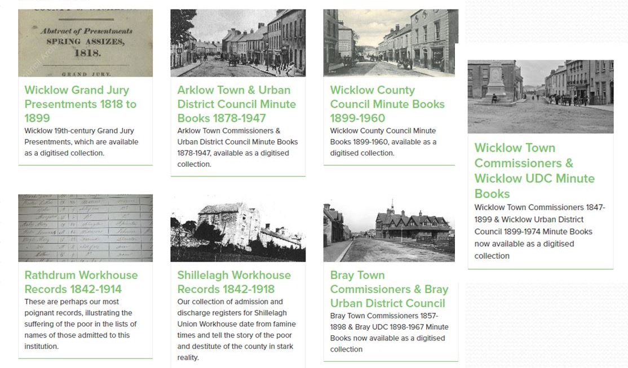
About the Archives
Digitised Collections
Many popular collections are now digitised and freely available including 19th century Grand Jury and council minutes. More to follow soon..

Slide 5
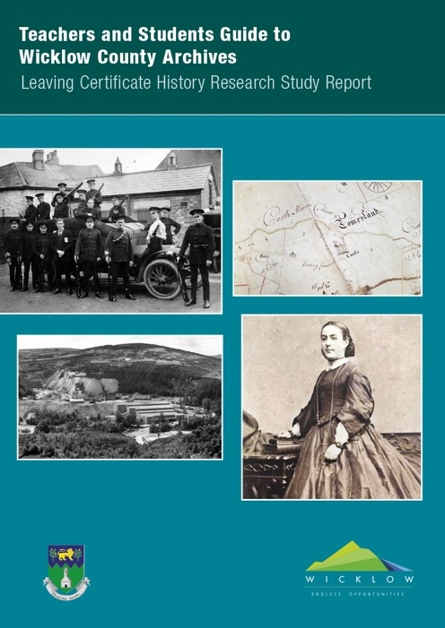
The Guide to Wicklow County Archives
A guide to the archives and its related resources has been developed for students beginning work on their History Research Study Report.
It explores the material available in the context of carrying out research on an historical topic
Associated with this guide are a range of resources to help you complete your history RSR.

Slide 6
Selecting a topic
In order to give you a chance to find out something interesting you should:
Select a topic which is easy to find information about
One where you can choose a small, focused, subject
It is historically important, nationally or internationally

Slide 7
Types of information sources
Primary sources:
Newspapers of the time
Records of events at the time
State and local government papers
Formal enquiries and investigations
Census records
Recorded interviews
Letters, journals and diaries written at the time
Biographies, speeches
Historic Maps
Historic photographs, paintings and drawings

Slide 8
Types of information sources
Secondary sources:
History books on the topic
Biographies
High quality history websites
TV, film and radio documentaries
Podcasts

Slide 9
Sources of Information
Possible sources of information are:
Wicklow County Archives
Wicklow Local Studies Library
You local Library
Websites – Our Wicklow Heritage
Local History Books
Other Websites
Newspapers
Historic Maps
Historic photographs, painting and drawings
Local Heritage Centres

Slide 10
How to carry out your research – A case study
The remainder of this presentation shows how, once you’ve selected your topic, you can undertake your research.
Topic summary
Sources of information – and recording the sources
Evaluation of sources

Slide 11
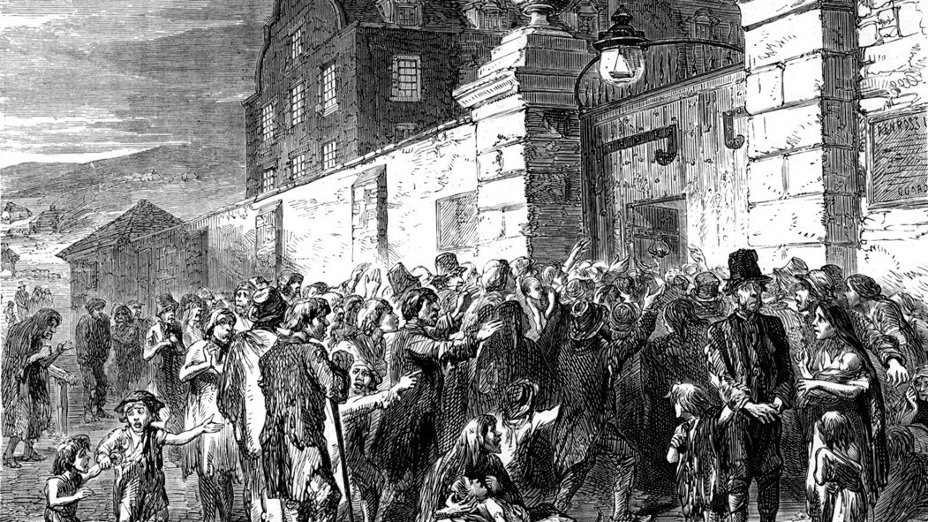
Case Study: The Famine in Co. Wicklow
No other event in Irish history has had such an enormous effect on the country than the famine of 1845 – 1849. The country’s population fell from around 8.4 million to 6.6 million by 1851 and, of these some 1 million died of starvation and disease and between 1845 and 1855 around 2 million emigrated.
Wicklow was not the worst effected county in Ireland. Nevertheless its population fell by 30%, from 110,000 in 1821 to 78,000 in 1871.
The Workhouse and Poor Law records of Rathdrum and Shillelagh, provide a fascinating insight into the hardships which ordinary people suffered at the time.

Slide 12
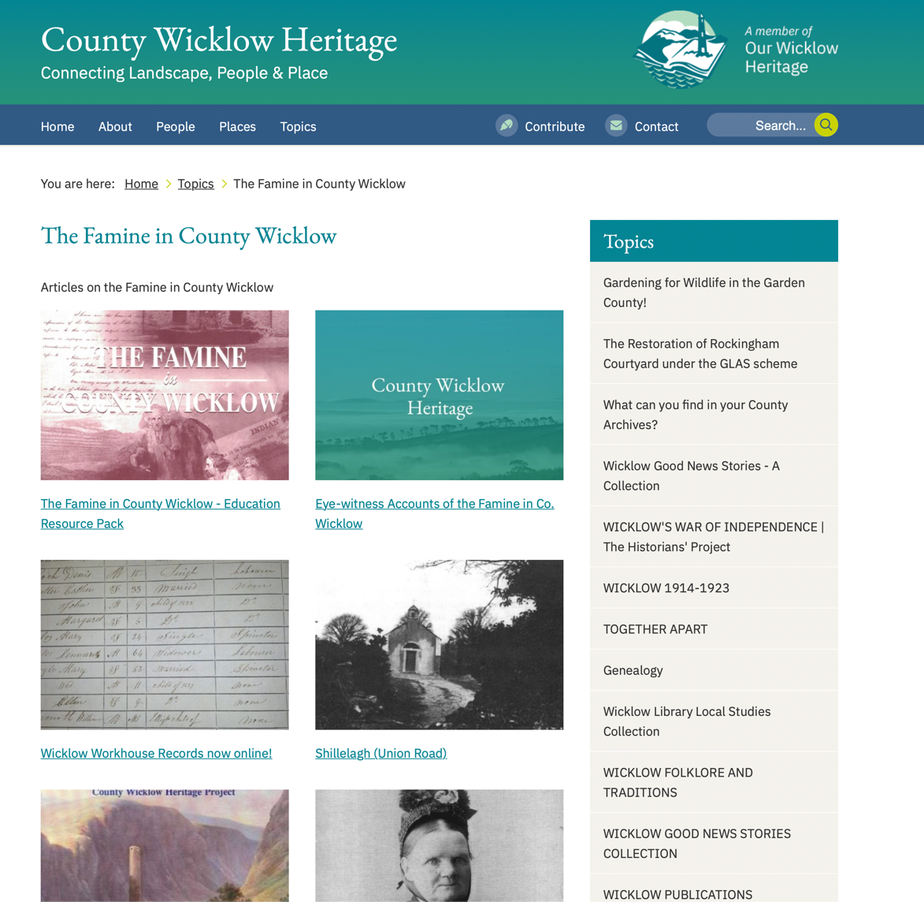
Information Sources
Website: https://heritage.wicklowheritage.org/category/topics/the-famine-in-county-wicklow

Slide 13
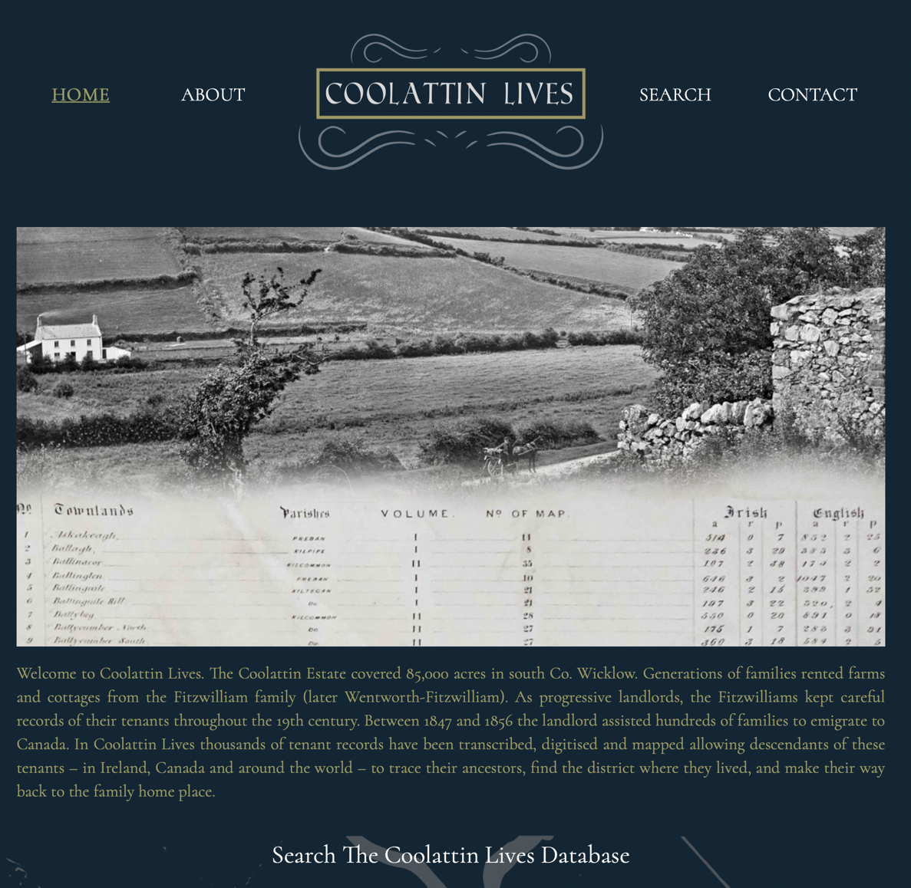
Information Sources
Website
https://coolattinlives.ie

Slide 14
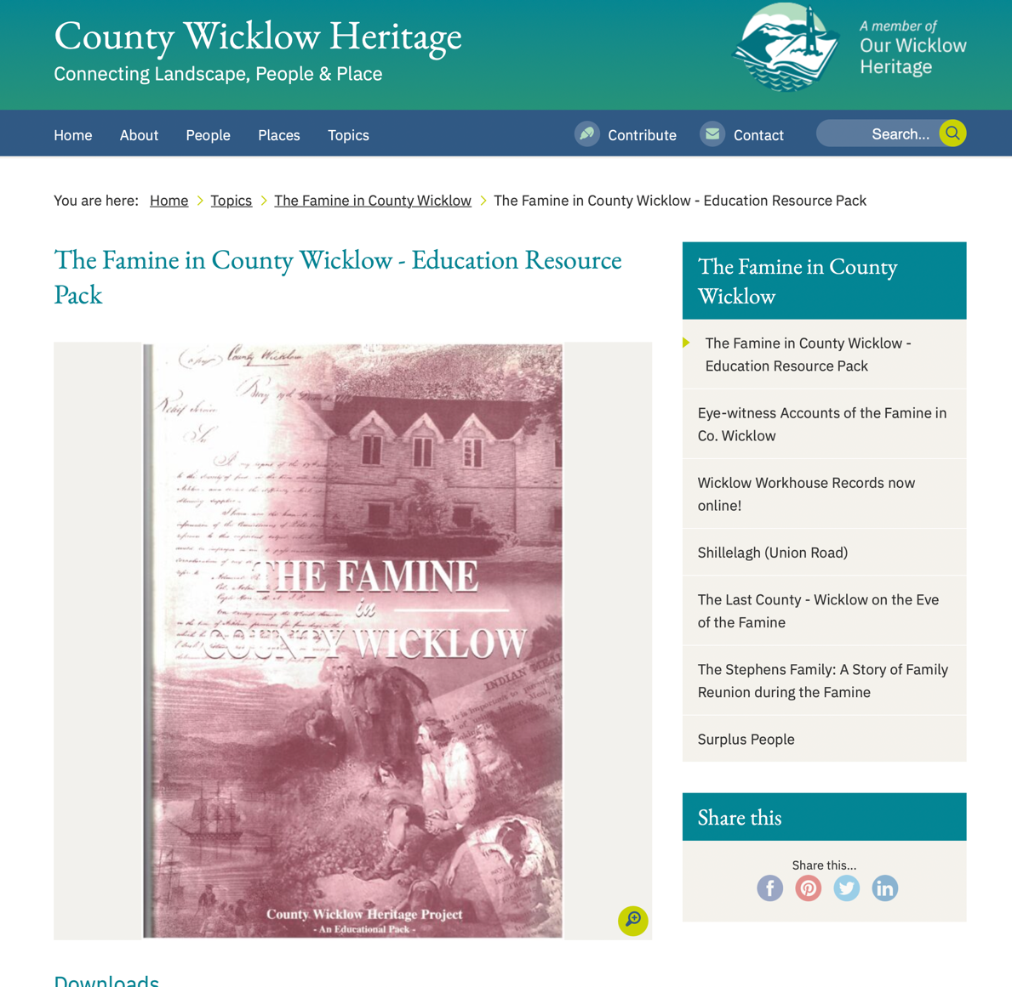
Information Sources
Website
https://heritage.wicklowheritage.org/topics/the-famine-in-county-wicklow/the-famine-in-county-wicklow-education-resource-pack

Slide 15
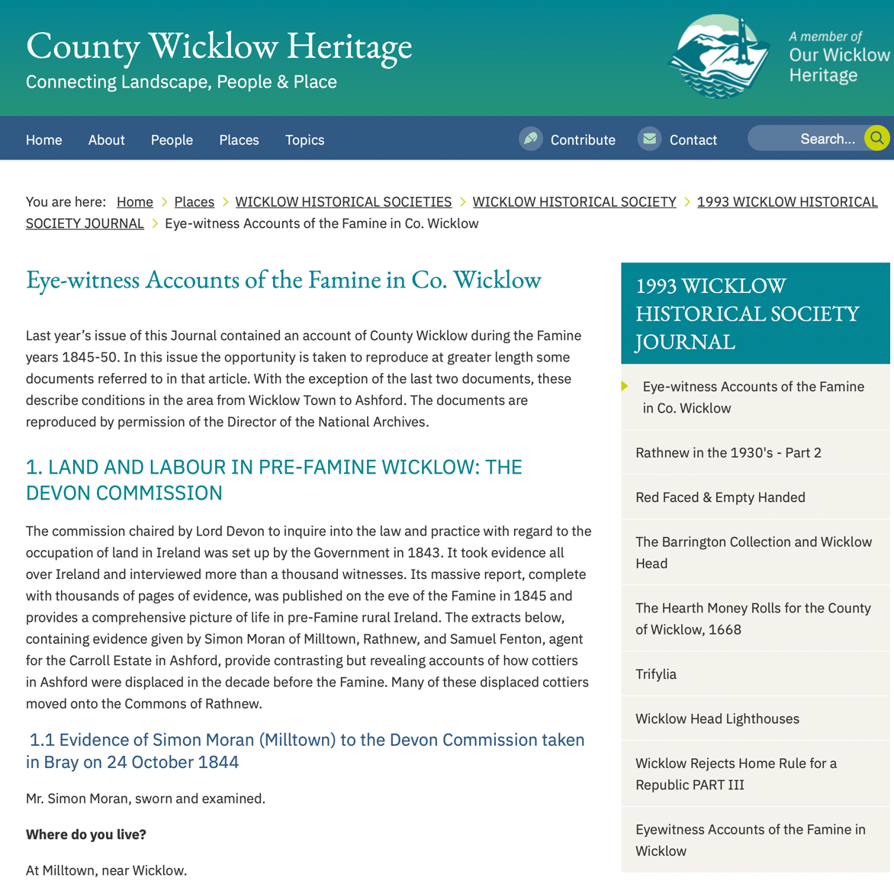
Information Sources
Website
https://heritage.wicklowheritage.org/places/county_wicklow_historical_societies/wicklow_historical_society/1993_wicklowhistorical_society_journal/eye-witness_accounts_of_the_famine_in_co_wicklow

Slide 16
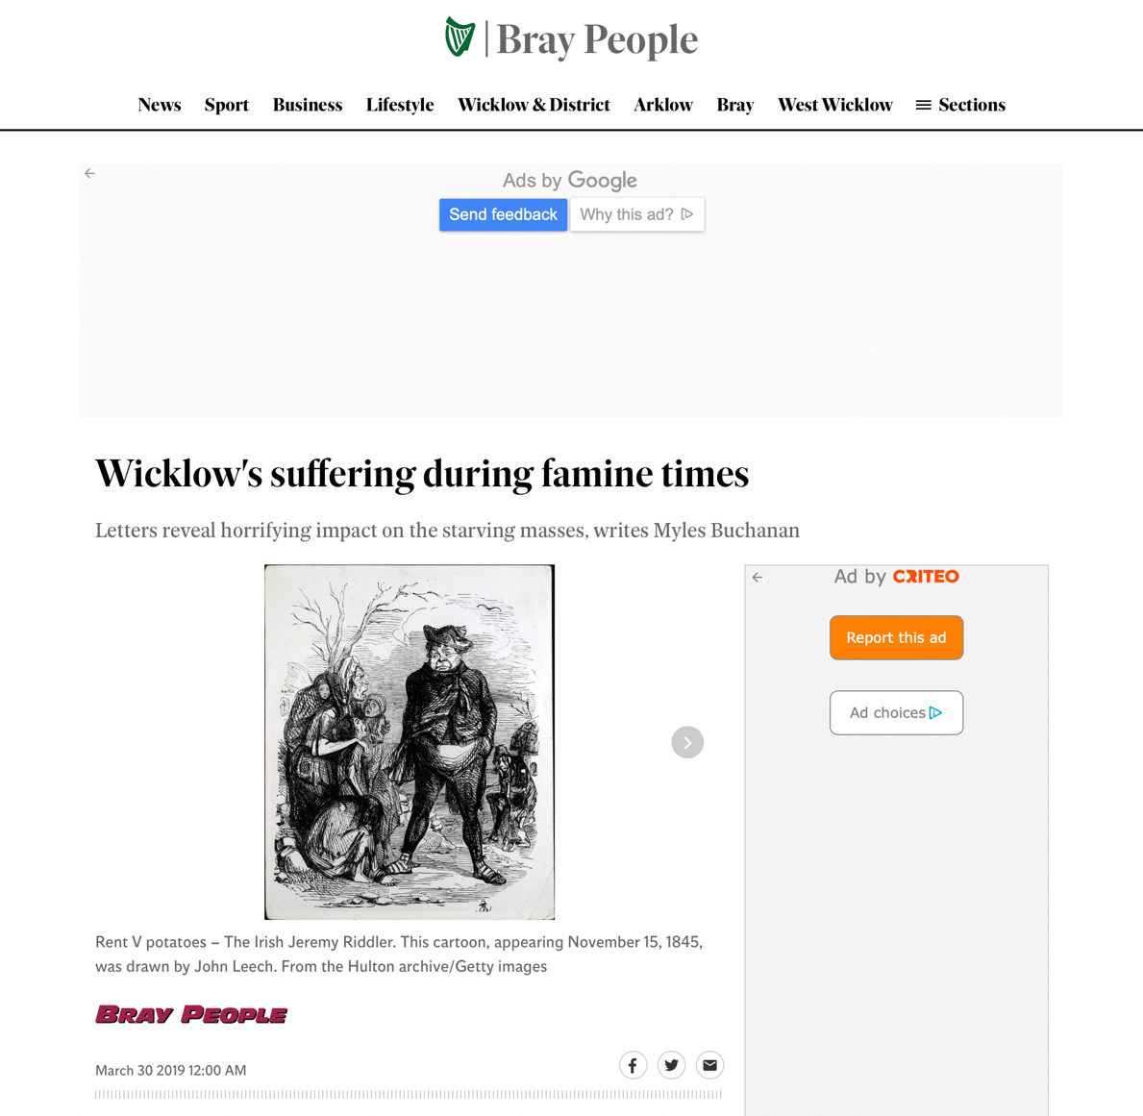
Information Sources
Website
https://www.independent.ie/regionals/braypeople/news/wicklows-suffering-during-famine-times-37953727.html

Slide 17
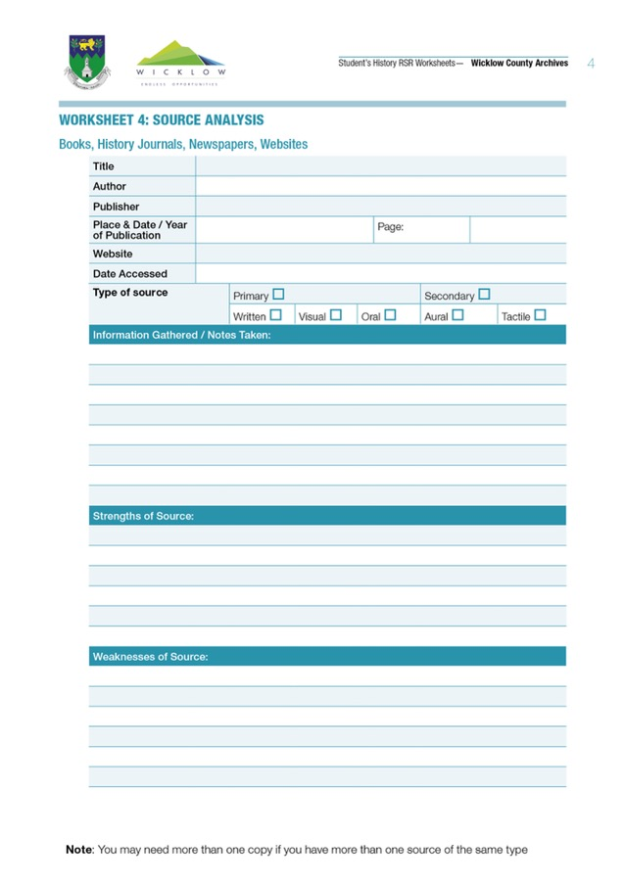
Assessment of Web Sources
Worksheet 4 – Source Analysis, is used to record what you’ve found out about the topic and to record the source information.
The four web pages provided a great overview of the impact of the Famine in Wicklow. The eye-witness reports and the Bray People article put a human face to the suffering. The Coolattion Lives site provides details of individuals and families on the estate during the period.
The Famine in Wicklow educational pack, in particular, provides a vast amount of information on the county at the time, the impact of the famine and the role of the Poor Law Unions and the Workhouses in attempting to alleviate the suffering.

Slide 18
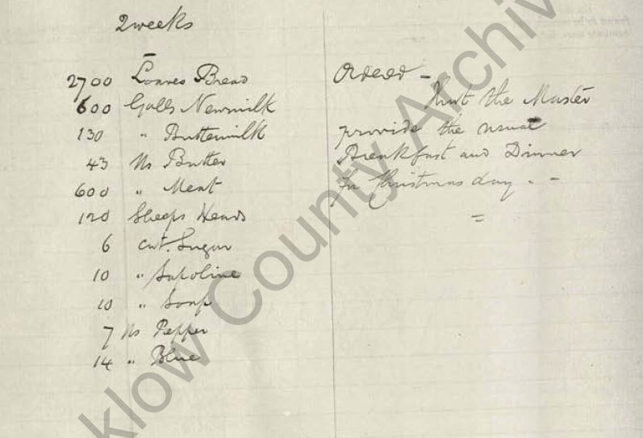
Information Sources
Official records These records from the time are primary sources. All are from the Wicklow County Archives collection.
Rathdrum Poor Law Union
List of food required for 1 week in Rathdrum Workhouse.

Slide 19
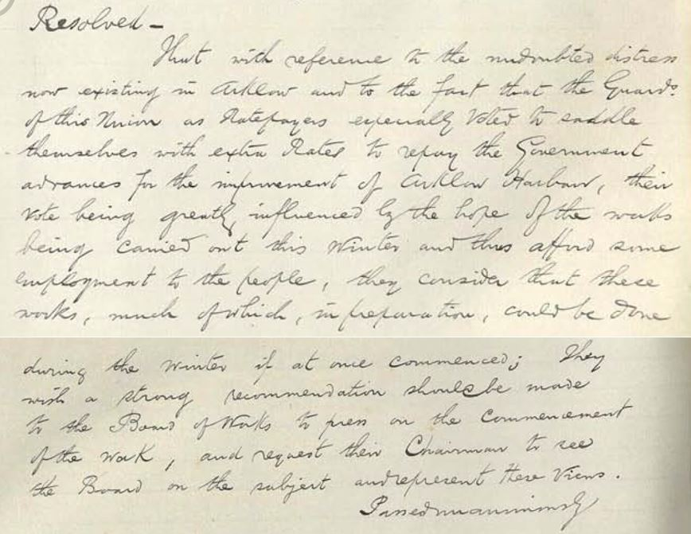
Information Sources
Official records These papers from the time are primary sources. All are from the Wicklow County Archives collection.
Rathdrum Poor Law Union
Improvement of Arklow Harbour as part of the Famine Relief works.

Slide 20
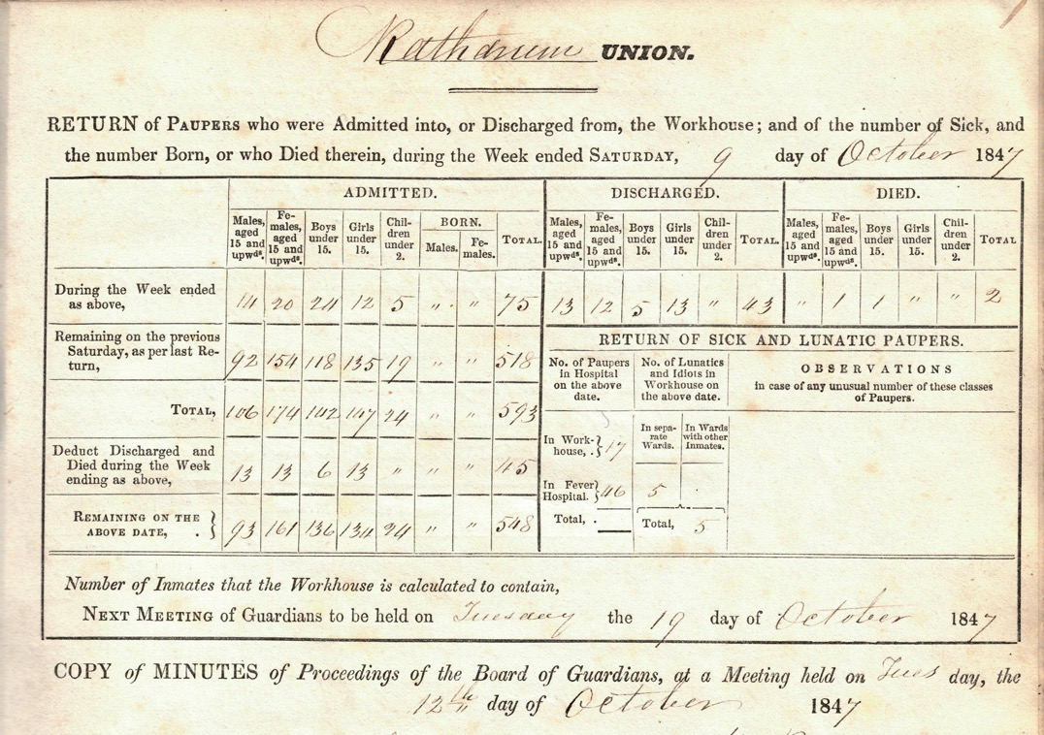
Information Sources
Official records These papers from the time are primary sources. All are from the Wicklow County Archives collection.
Rathdrum Poor Law Union
Record of occupants at Rathdrum workhouse, October 1847.

Slide 21
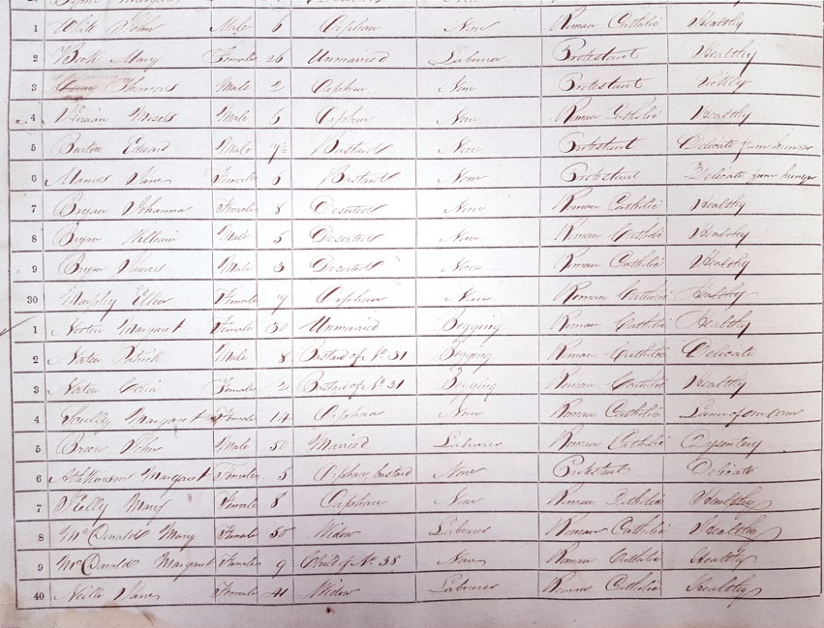
Information Sources
Official records These records from the time are primary sources. All are from the Wicklow County Archives collection.
Shillelagh Poor Law Union
Register of admissions to workhouse, 1847, the persons age and status occupation and religion. Four children from one family, aged 3 – 8, had been deserted.

Slide 22
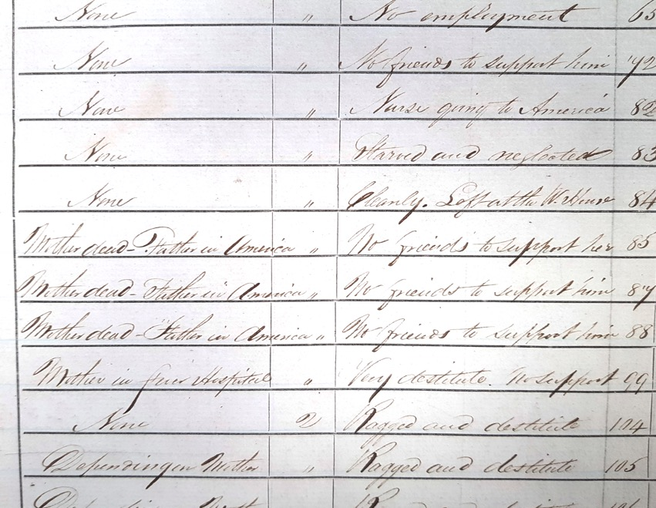
Information Sources
Official records These papers from the time are primary sources. All are from the Wicklow County Archives collection.
Shillelagh Poor Law Union
Register of admissions to workhouse, their condition and the reason for admission, 1847 “deserted…mother and father in America”

Slide 23
Assessment of Official records
Worksheet 4 – Source Analysis, is used to record what you’ve found out about the topic and to record the source information.
The articles provide an interesting insight into how the local Poor Law unions responded to the famine.
The records show a surprising amount of information on individuals, their health, religion, status – married, widow, etc., and their occupation if they were employed.

Slide 24
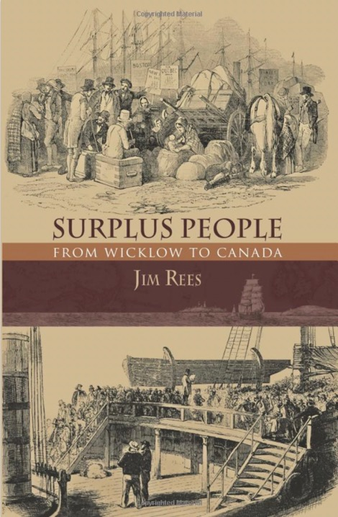
Information Sources
History Books This book, which is a secondary source, was found in the Wicklow Local Studies Library collection. It may also be available on loan from your local library.
Surplus People, Jim Rees Published by The Collins Press 2014
A comprehensive history the Fitzwilliam estate Coolattin with a particular focus on the famine period and the emigration of over 6,000 of the estate’s tenants.

Slide 25
Assessment of the History Book
Worksheet 4 – Source Analysis, is used to record what you’ve found out about the topic and to record the source information.
Surplus People provided a great deal of general information on the famine. In addition, it provided a wealth of information on the Coolattin Estate’s reponse.
This sources, in addition to the Famine in Wicklow educational pack, provided the bulk of the information for the RSR project.

Slide 26
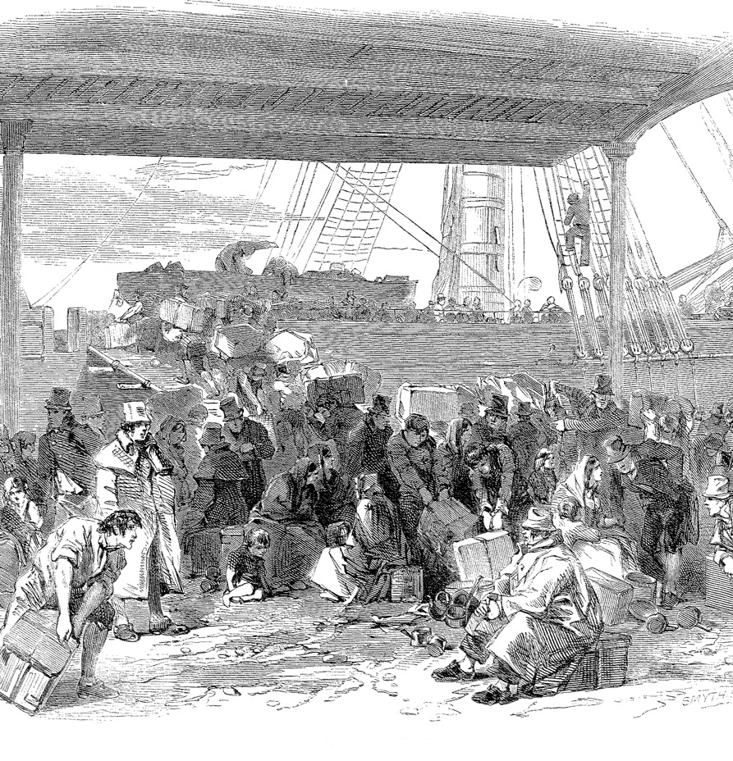
Conclusion
Using three types of sources, websites, official firsthand records and local history books, it was possible to build up a good picture of Wicklow during the famine period.
The websites provided a good, general overview of the history of the famine in Wicklow, with records of eye-witnesses.
The Famine in Wicklow educational pack provided very useful information on the overall impact of the famine and official responses to the crisis.
The Rathdrum Poor Law Union correspondence provided useful information on local efforts to alleviate hardship.
Surplus People provided most of the detailed information on the famine in Wicklow and the Coolattin Estate’s response.

